Slide 1
OFDM modulation
By Mohamed Ibrahim and Shuihan Liu

Slide 2
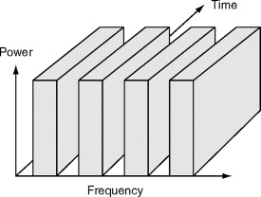
FDM (Frequency-division multiple)
FDM (Frequency-division multiple access) :
It allows multiple users to send data
through a single communication channel,
it divides the bandwidth of the channel
into separate non-overlapping frequency sub-channels
in order to make each signal can be transmitted separately.
So, each user can have a sub-channel by modulating the frequency.
Figure 1. FDM assigns multiple sub-channels.
(Adapted from https://www.sciencedirect.com/topics/engineering/frequency-division-multiple-access )

Slide 3
Problems with FDM traditionally
Although FDM is a good method but it also has problems:
Only modest capacity improvements could be expected from a given spectrum allocation.
If an FDM channel is not in use, it is wasted and can not be used by anyone else.
FDM has higher cell site system costs since it uses a costly bandpass filter to eliminate
spurious radiation at the base station.
On a mobile FDM unit, it uses duplexers because the transmitter and receiver will work
simultaneously and it adds weight, size and cost to it.
The maximum bit rate of each channel is fixed and small.
FDM requires tight RF filtering to minimize adjacent channel interference(ACI).

Slide 4
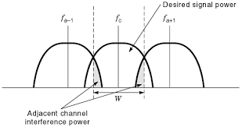
ACI (adjacent channel interference)
The signal which is adjacent in frequency to the desired signal will cause ACI,
this signal can pass the bandpass filter because it is a nearby frequency.
This can be reduced by :
Using modulation schemes which have low out-of-band
radiation
Redesign the bandpass filter at the receiver end.
Assign adjacent channels to different cells in order to keep the
frequency separation between each channel in a given cell
as large as possible.
Use advanced techniques that employ equalizers.

Slide 5
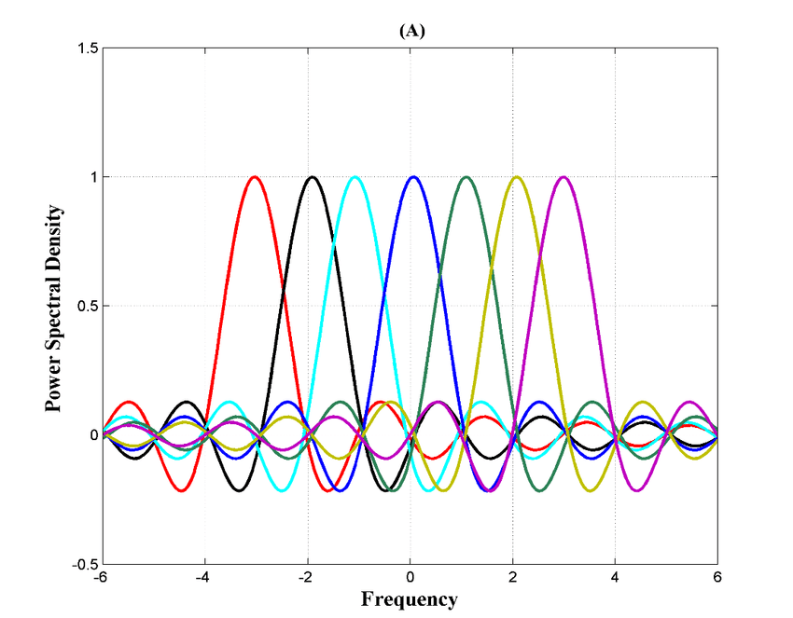
Motivation for OFDM
OFDM is a multicarrier digital communication scheme to
solve the uses like combining a large number of low data rate carriers to construct a composite high data rate communication system.
Figure: Multi-carriers of OFDM signals

Slide 6
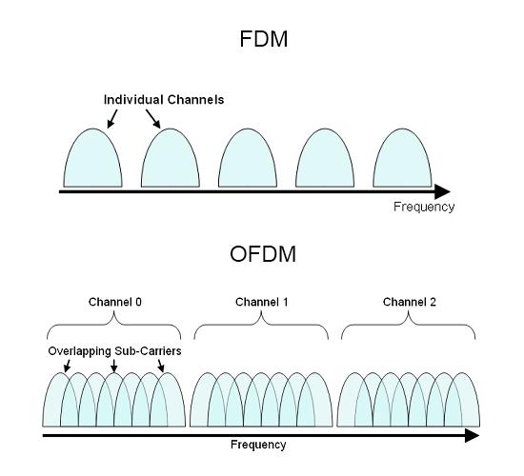
Improvement of traditional FDM - OFDM
Difference between OFDM and FDM

Slide 7
What are the key features?
OFDM has more features other than overlapping sub-carriers:
Multiple carriers (called subcarriers) carry the information stream.
The subcarriers are orthogonal to each other.
A guard interval is added to each symbol to minimize the channel delay spread and intersymbol interference.

Slide 8
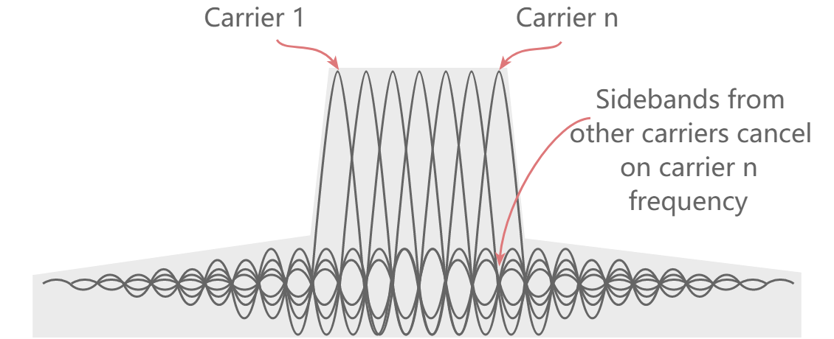
Orthogonality
OFDM is special comparing to FDM, one of the reason is because OFDM has the the additional constraint that all subcarrier signals within a communication channel are orthogonal to one another.
In OFDM, the available bandwidth is divided into subcarriers and data is transmitted on them in parallel. Each of the subcarriers can be modulated using a different modulation technique.

Slide 9
Achieve synchronization!
Synchronization process
Frequency and timing estimation
Timing and frequency correction

Slide 10
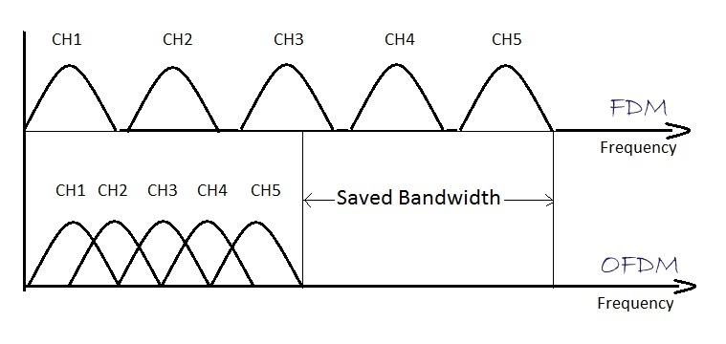
Advantages
Save bandwidth: Spectrum efficiency
Immunity to selective fading
Resilience to interference
Resilient to ISI (inter-symbol interference)
Resilient to narrow-band effects
Simpler channel equalisation
Figure: Bandwidth usage of OFDM & FDM

Slide 11
Disadvantages as well
High peak to average power ratio
Sensitive to carrier offset and phase noise

Slide 12
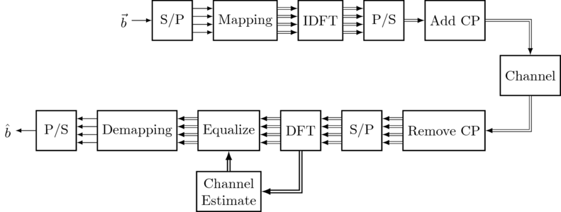
OFDM
Figure : fundamental blocks for the OFDM system
Adapted from : https://dspillustrations.com/pages/posts/misc/python-ofdm-example.html

Slide 13
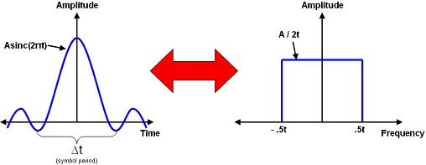
Pulse shaping
Figure : Time vs. Frequency Domain for a Sinc Pulse

Slide 14
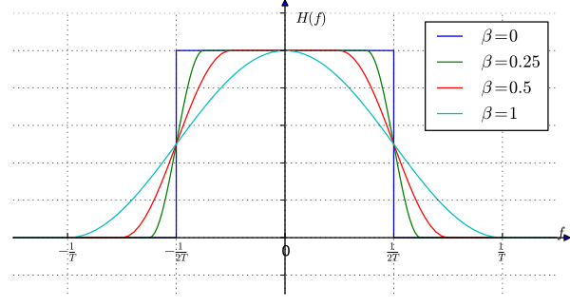
Pulse shaping filters
Sinc shaped filter
Raised-cosine filter
Gaussian filter
Figure: Amplitude response of raised-cosine filter with various roll-off factors

Slide 15
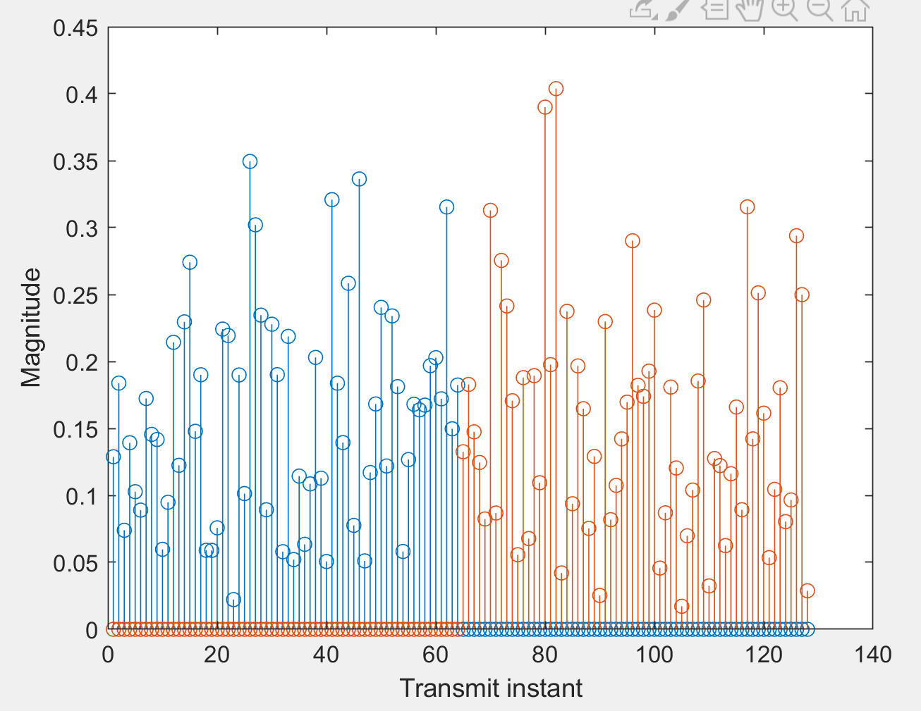
Role of Cyclic Prefix
The Cyclic Prefix aims to reduce Inter-Block Interference between OFDM symbols.
To understand this we need to first understand the concept of frequency selective channels.

Slide 16
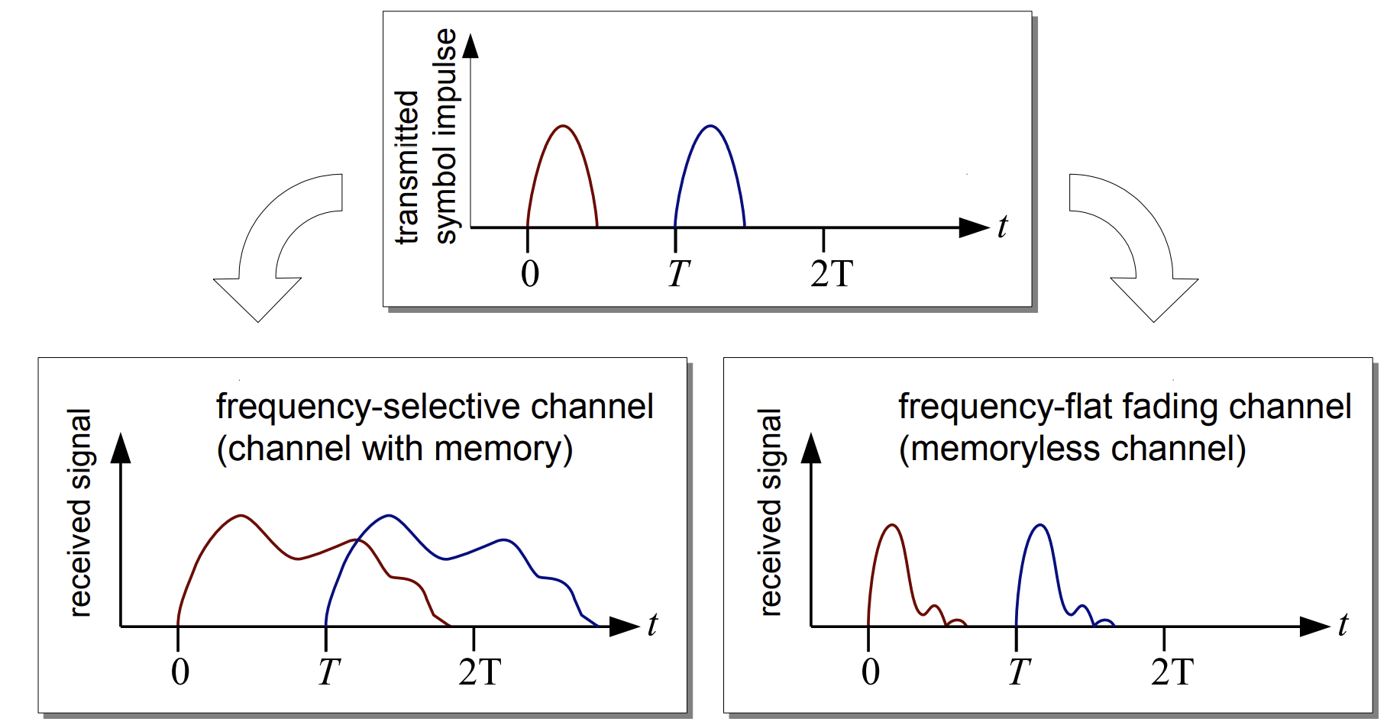
Frequency selective channels
As the channel has memory, the output at one instant can be modelled using a difference equation, i.e.
Y[n] = aX[n] + bX[n-1] + cX[n-2]...
[1]

Slide 17
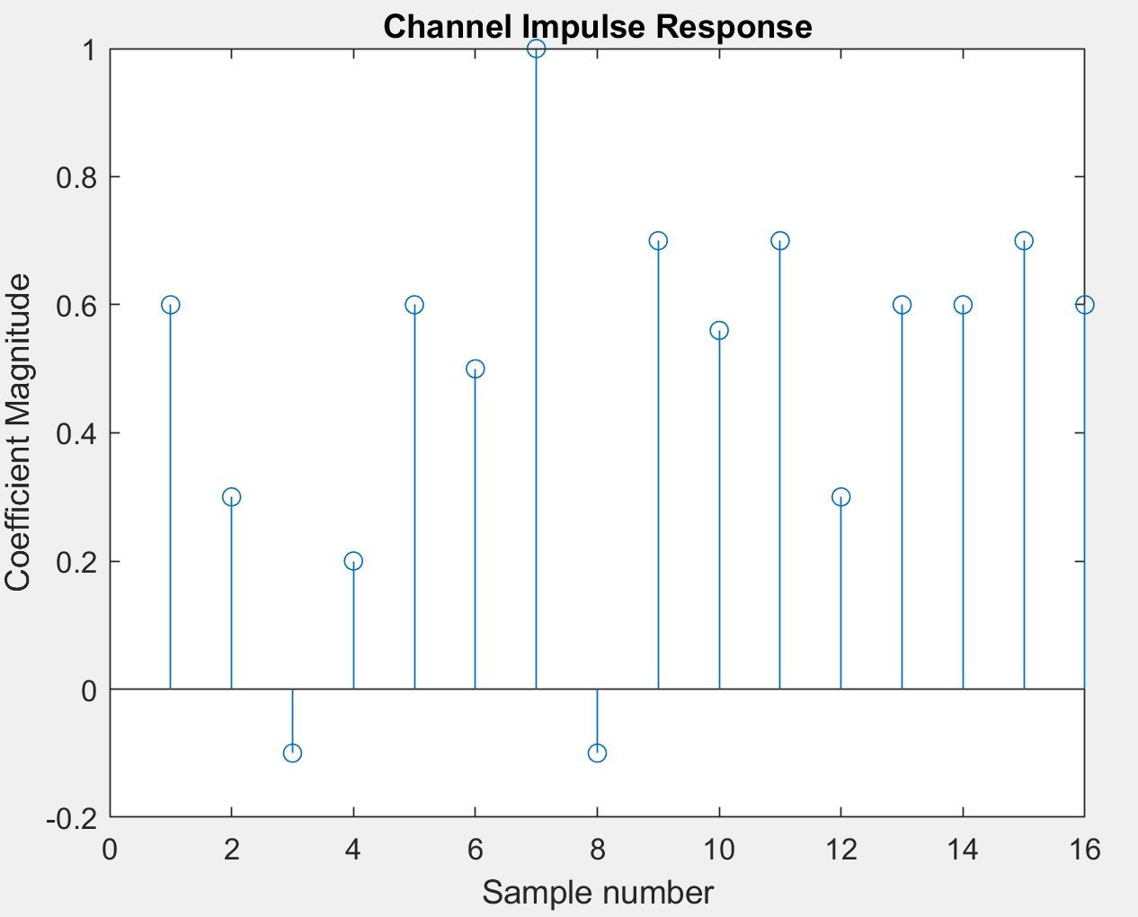
Effect of Frequency Selective Channels
Linear Convolution between signal and channel impulse response.

Slide 18
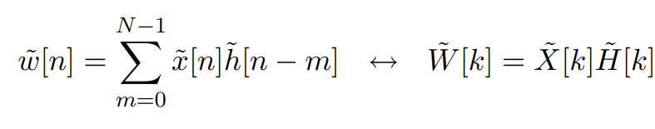
Discrete Fourier Transform (DFT/FFT)
Creates a N-point frequency domain representation from an N-point input.
Based on Discrete Fourier Series.
Multiplication of two DFT sequences is equivalent to circular convolution in the time domain, i.e.

Slide 19
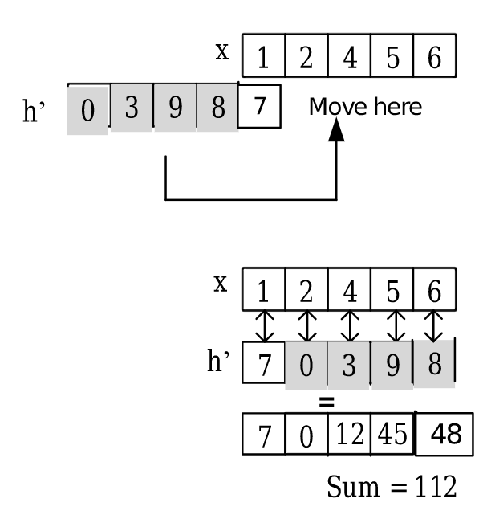
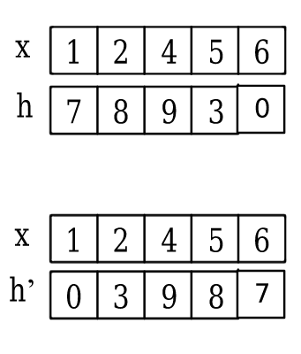
Illustrating Circular Convolution
[2]

Slide 20
Can Circular Convolution Help Us?
Yes!
Changing the type of convolution to circular convolution will allow us to obtain the pointwise product between the channel frequency domain response and the ofdm symbol.
This can allow for a single-tap channel equalization method based on channel estimation results.

Slide 21
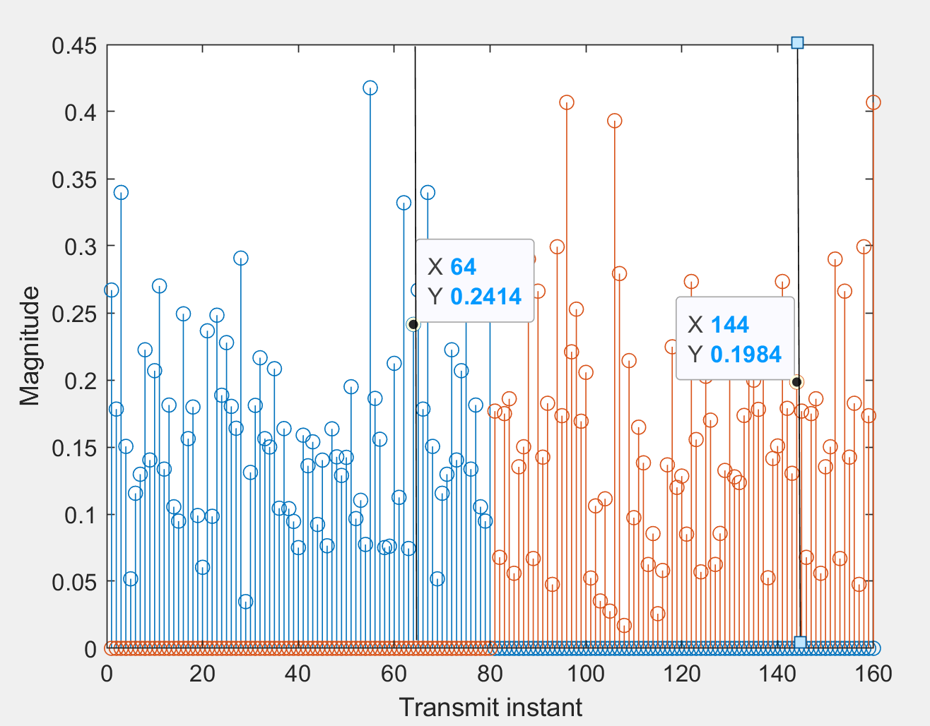
How Cyclic Prefix Aids Circular Convolution
Suppose we send X, Y and receive X’, Y’.
Y’[0] = aY[0] + bY[N-1] + cY[N-2]...

Slide 22
Designing Cyclic Prefix Length
Cyclic prefix has to be greater than or equal than the length of channel impulse response.
Therefore, the cyclic prefix has to be adjusted depending on the communication environment.
E.g. LTE has different length of a symbol cyclic prefix depending on mode of operation, e.g. 160, 144, 512 out of 2048 symbols per ofdm symbol [3].

Slide 23
References
[1]: D.Schulz, “MATLAB Models for PHY”, TU Illumenaz, 2016.
[2]: N. Abbasi, “A simple method to do circular convolution”, 2020.
[3]: “LTE In a Nutshell: The Physical Layer”, 2016.

